Slide 1

Visual Wave
Eye Candy Music Player
<Team1> 20182705고주형 20185784김호성 20182610손희승 20162874이준협 20142611이하람

Slide 2

What

Slide 3
Before we start

Slide 4
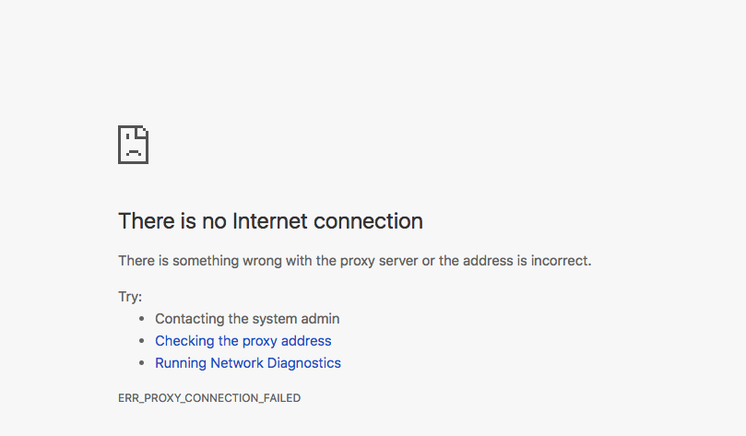
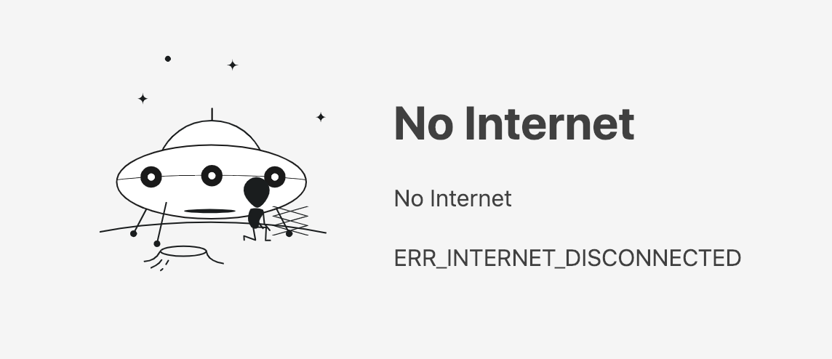
If there is no internet
It is empty and boring
Then user just exits

Slide 5

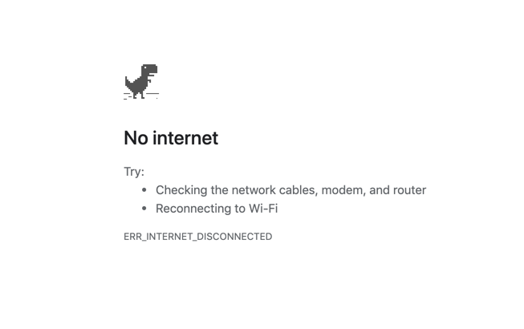
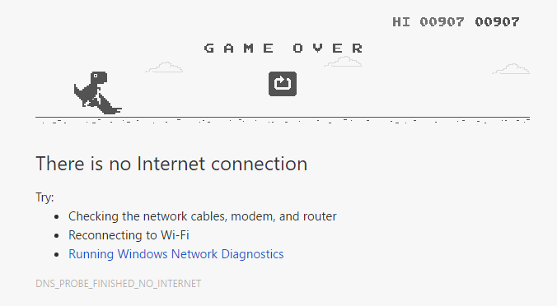
Have you used Google Chrome?
With Dinosaur
Not boring
Fun and Addictive

Slide 6
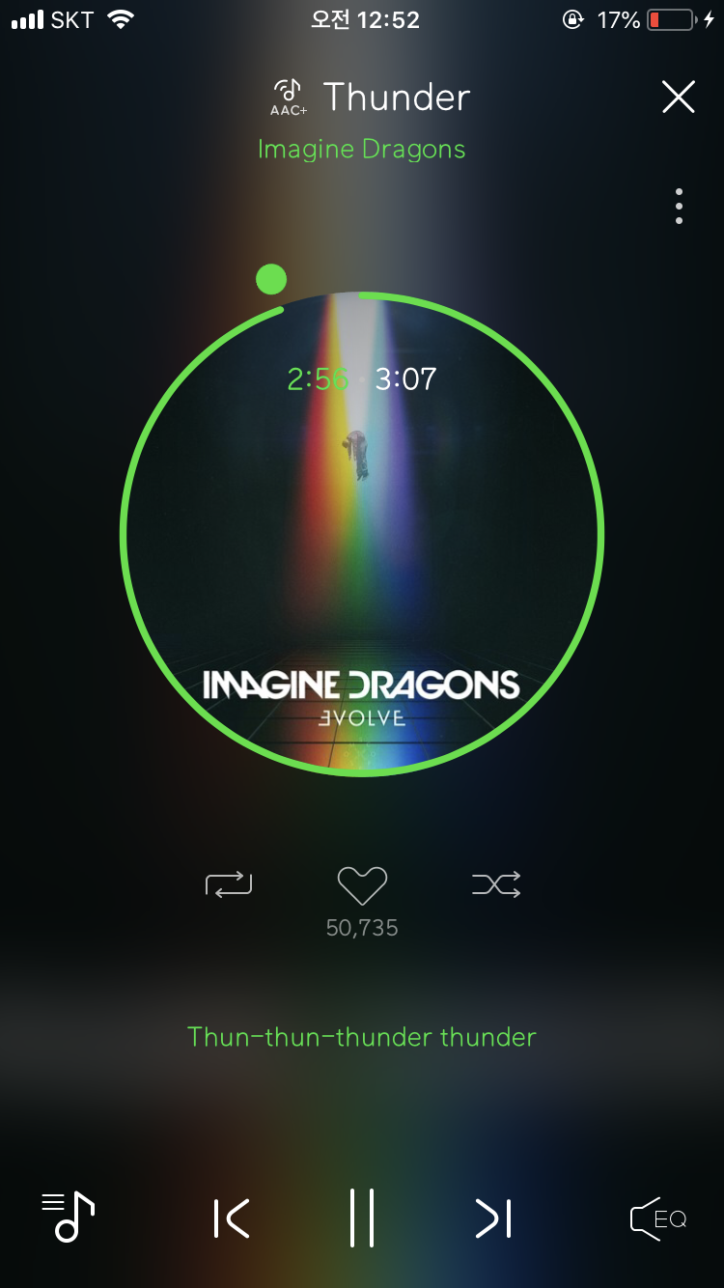
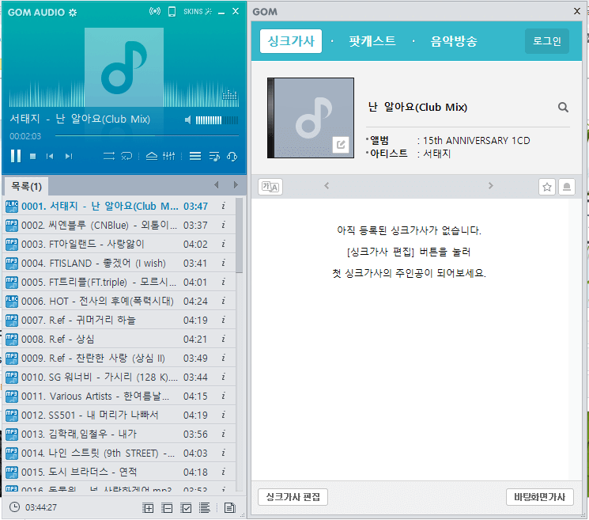
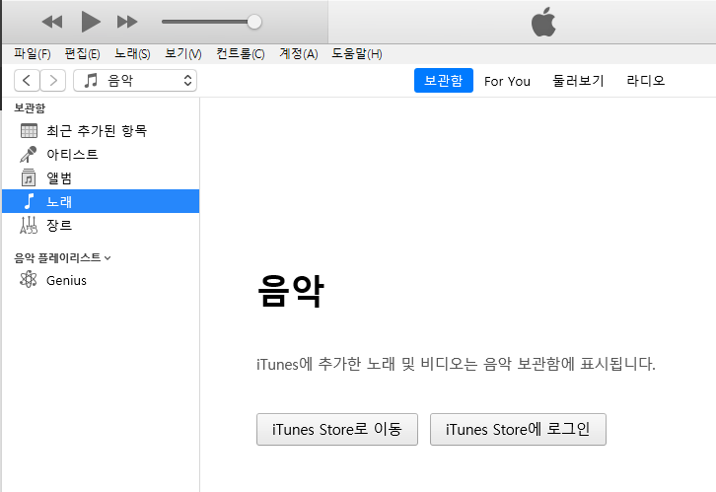
Existing Music Player’s Screen
Album
Basic Picture
Lyric
There’s no interaction!

Slide 7
So Here’s What we wanted to make
More Interactive
Eye Candy
Feel more
while listening

Slide 8

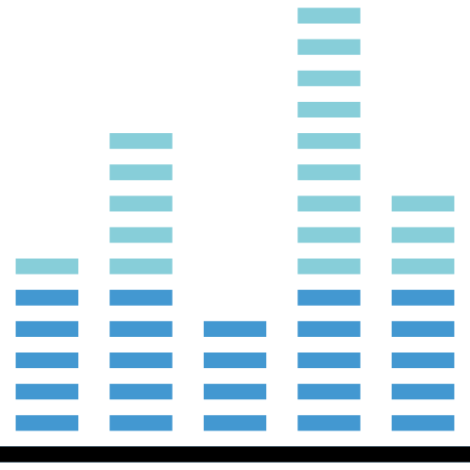


Music Player + Visualizer + Game

Slide 9
Music Player Functions
Play
Stop
Pause
Playlist with Drag and Drop

Slide 10
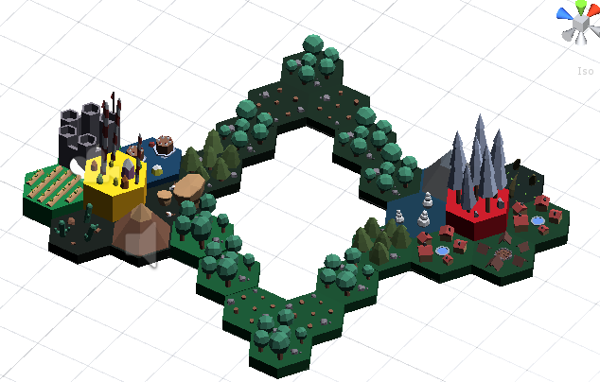
Visualizer
3D Animated Visualizer

Slide 11
Game
Play Game with visualized graphic

Slide 12

So Finally Introducing…!
Music Player + Visualizer + Game
⇒
Visual Wave

Slide 13
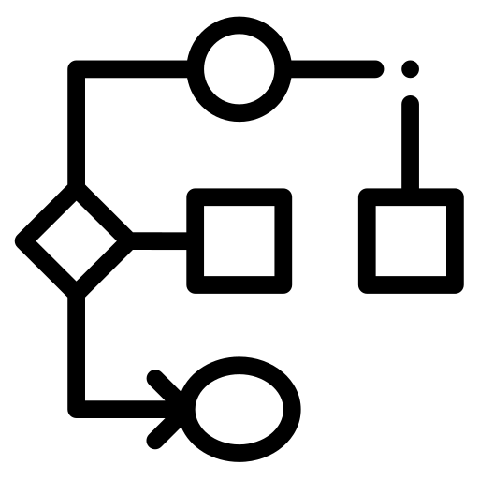
Use Case Diagram
준협형 USECASE DIAGRAM 삽입

Slide 14

How

Slide 15
Core Classes
Controller Class
Start, Stop, and Skips Music and Controls UI of it
Playlist Class
Manages Music
Database Manager Class
Add, Delete, Save, Load, … operation on Playlist
UI Manager Class
Manages Pop Up UI (Add or Delete Playlist, Add or Delete or Select Music UI)
BPM Manager Class
Handles BPM based on current music clip data : Used
Visualize Color / Size
Visualizes current music with color and size

Slide 16
Class Diagram
준협형 CLASS DIAGRAM 삽입

Slide 17

Demo

Slide 18
Let’s Watch Our Demo

Slide 19
Thank You

